Slide 1
Water supply from source to consumer
Marisa Boller
ENV 402 Lecture #9
EPFL, GRA 331
14 November 2024
10:15-12:00

Slide 2
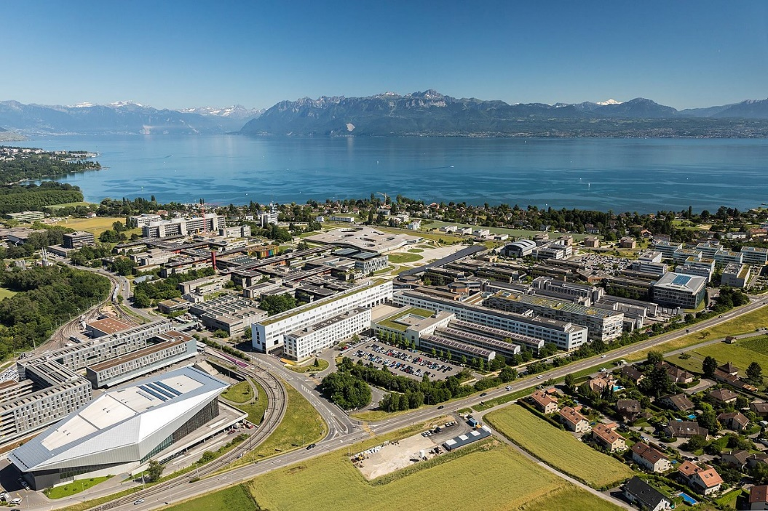
A little about me..
Education: BSc & MSc Environmental engineering (EPFL)
Eawag / Sandec: Project Officer, Water Supply and Treatment (Feb. 2023 – present)
Interests: Drinking water safety in rural communities and small towns, treatment innovation… just WASH+SWM in general
2

Slide 3
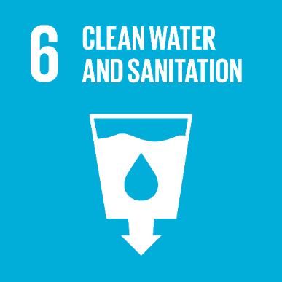
Motivation: Addressing inequalities in access to safe water
Source: UNICEF/WHO JMP, 2019
3

Slide 4
Learning objectives
By the end of the class, you’ll be able to:
Understand the objectives and structure of the Water Compendium
Recognize the six functional groups from source to consumer
Describe the advantages and drawbacks of (a selection) of water supply technologies
Illustrate a system template for a ‘real world’ scenario
4

Slide 5
Lecture
Part 1 | Technology overview Introduction to the Water Compendium Functional groups Schematic presentation Applicability, operation and environmental aspects
 | 15 min break
Part 2 | Water system design System templates Design tradeoffs and local applicability Group exercise
 | Discussion
5

Slide 6
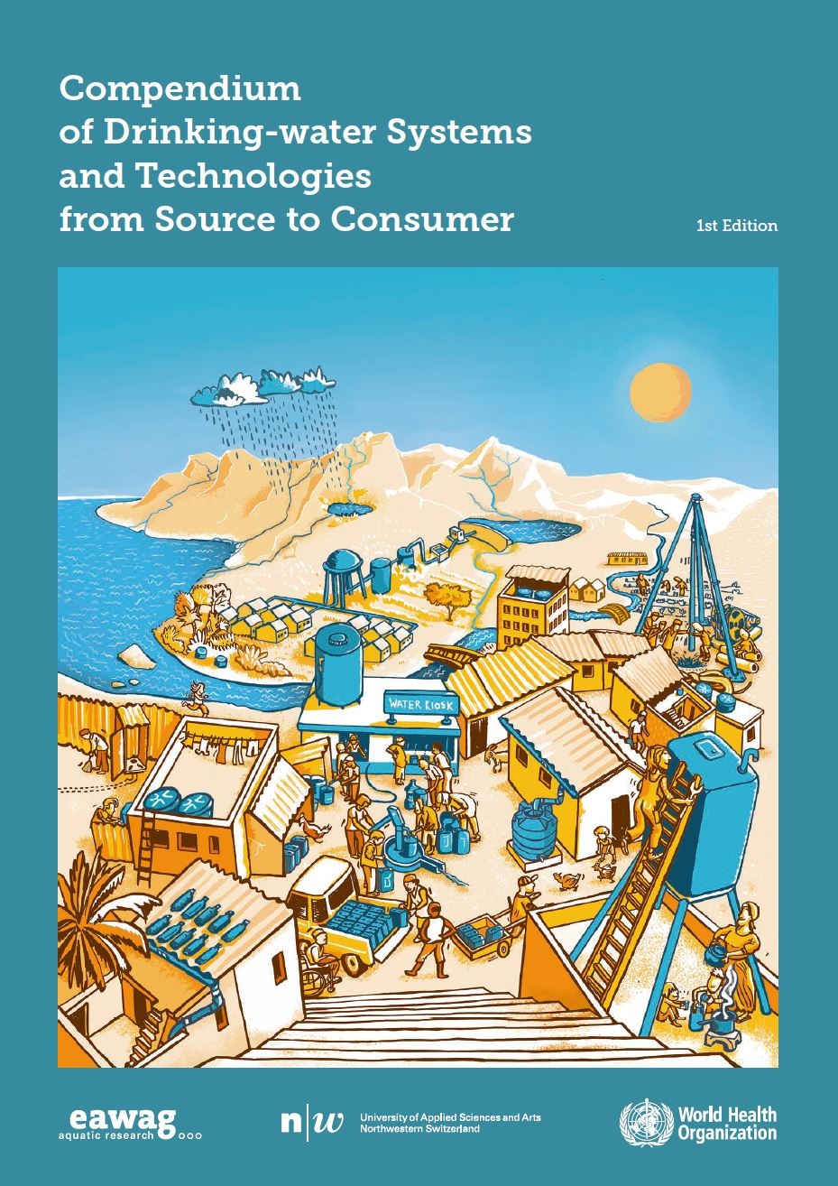
Learning objective 1:
Understand the objectives and structure of the Water Compendium
Learning objective 2:
Recognize the six functional groups from source to consumer
6

Slide 7
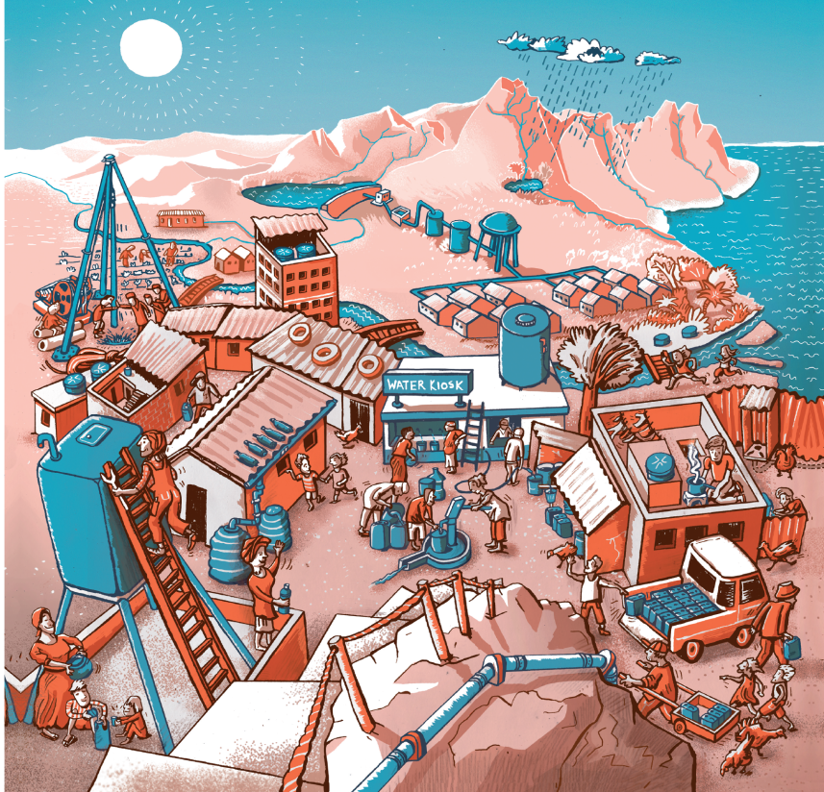
How to choose an appropriate drinking water supply system?
Important considerations:
Source water quality and quantity
Locally available skills and resources to operate and maintain
Cultural preferences
Space availability
Source of energy
Environmental impacts
7
Notes:
Technology design and implementation involve consideration of various aspects such as source water quality and quantity, locally available skills and resources to operate and maintain the technology as well as cultural preferences and environmental impacts.
A meaningful combination of technologies is in most cases necessary to achieve the WHO water quality standards for safe drinking water. The following factors should be considered when choosing a treatment method or combination of methods:
Available water resources and their seasonal quantity characteristics
Water contaminants and seasonal variations of contamination
Legal water quality and quantity requirements
The application of multiple barriers, which helps ensure that a failure of one barrier may be compensated by the effective operation of the remaining barriers
Scale
Availability of financial resources
Local availability of materials or need of imported products
Space availability
Availability of skills and local capacity for design, management, operation and safety
Sources of energy

Slide 8
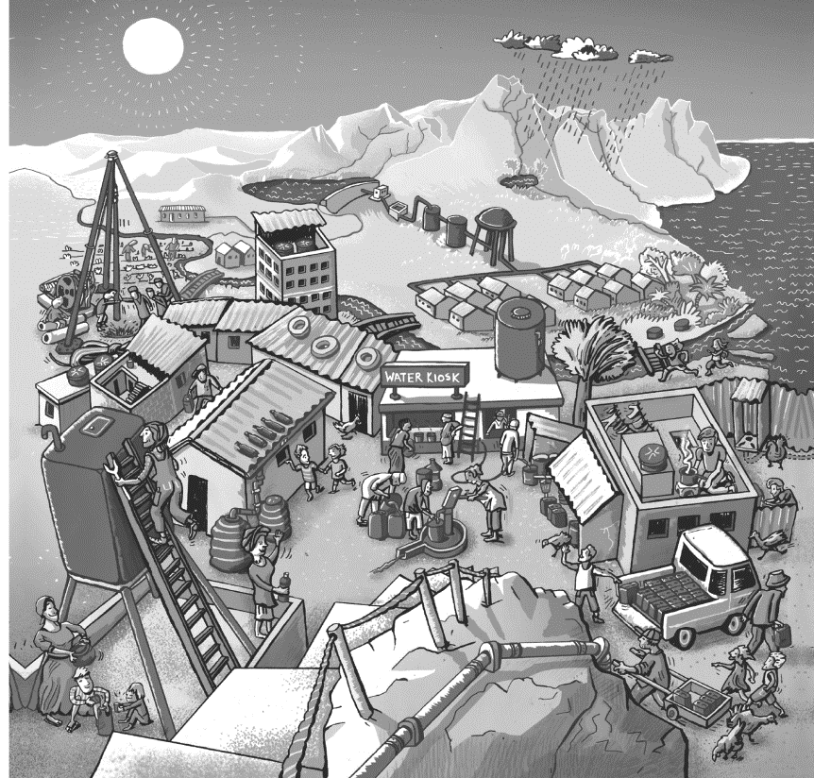
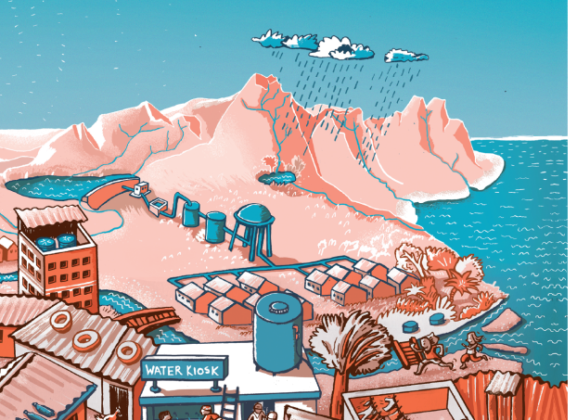
How to choose an appropriate drinking water supply system?
Centralized drinking water supply systems
source
intake
abstraction
treatment
distribution & transport
User safety
8
Notes:
Technology design and implementation involve consideration of various aspects such as source water quality and quantity, locally available skills and resources to operate and maintain the technology as well as cultural preferences and environmental impacts.
A meaningful combination of technologies is in most cases necessary to achieve the WHO water quality standards for safe drinking water. The following factors should be considered when choosing a treatment method or combination of methods:
Available water resources and their seasonal quantity characteristics
Water contaminants and seasonal variations of contamination
Legal water quality and quantity requirements
The application of multiple barriers, which helps ensure that a failure of one barrier may be compensated by the effective operation of the remaining barriers
Scale
Availability of financial resources
Local availability of materials or need of imported products
Space availability
Availability of skills and local capacity for design, management, operation and safety
Sources of energy

Slide 9
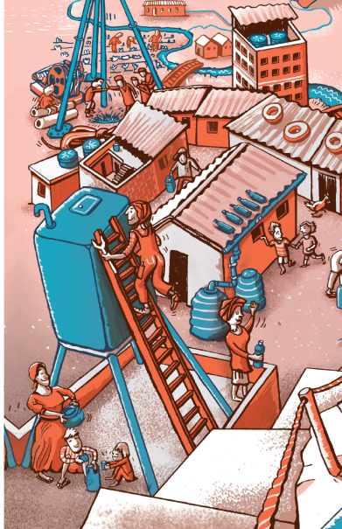
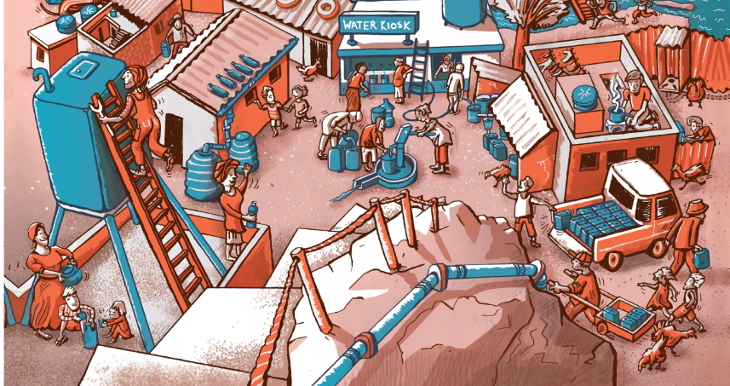
How to choose an appropriate drinking water supply system?
Decentralized drinking water supply systems
source
user safety
intake
user safety
distribution & storage
abstraction
distribution & storage
9
Notes:
Technology design and implementation involve consideration of various aspects such as source water quality and quantity, locally available skills and resources to operate and maintain the technology as well as cultural preferences and environmental impacts.
A meaningful combination of technologies is in most cases necessary to achieve the WHO water quality standards for safe drinking water. The following factors should be considered when choosing a treatment method or combination of methods:
Available water resources and their seasonal quantity characteristics
Water contaminants and seasonal variations of contamination
Legal water quality and quantity requirements
The application of multiple barriers, which helps ensure that a failure of one barrier may be compensated by the effective operation of the remaining barriers
Scale
Availability of financial resources
Local availability of materials or need of imported products
Space availability
Availability of skills and local capacity for design, management, operation and safety
Sources of energy

Slide 10
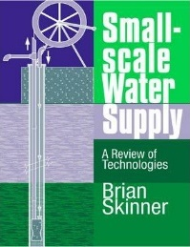
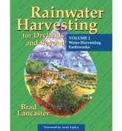


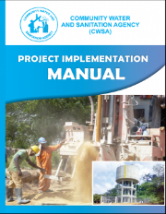

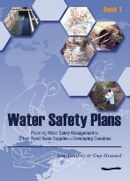
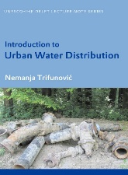
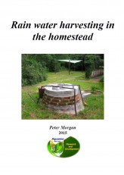


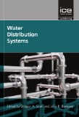

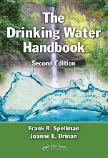
Objectives of the Water Compendium
Huge number of great publications on water supply
concise and well structured overview of all technological steps from source exploitation to household water treatment and storage
the whole range of rural, peri-urban and urban technologies (focus on the low and middle income setting)
issues of risk management and long term water safety, monitoring, financial and institutional aspects
10
Notes:
In low- and middle-income countries (LMICs) the choice of an appropriate drinking water technology and supply system is crucial to safeguard public health. Technology design and implementation involve consideration of various aspects such as source water quality and quantity, locally available skills and resources to operate and maintain the technology as well as cultural preferences and environmental impacts.
In low- and middle-income countries (LMICs) health risks associated with drinking water are a major concern. Poor water quality, sanitation and hygiene account for 1.7 million deaths due to infectious diarrhoea a year; among which 525’000 are children under five (World Health Organization, 2017). Improved drinking water treatment and supply are important measures to safeguard public health and improve the livelihoods of affected people. The ‘Compendium on Drinking Water Systems and Technologies from Source to Consumer’ aims to highlight important aspects to be considered when designing and implementing drinking water systems in LMICs.
Indicator 6.1.1 – Drinking water
A safely managed drinking water service is defined as an improved drinking water source that is located on the premises and available when needed, and free of faecal and priority chemical contamination. Improved water sources include piped water, boreholes or tubewells, protected dug wells, protected springs and packaged or delivered water.
Five billion people use a safely managed drinking water service.
Estimates for safely managed drinking water are available for 96 countries and four out of eight SDG regions.
One billion people use a basic drinking water service.
Eight hundred and forty-four million people still lack even a basic drinking water service.
Two hundred and sixty-three million use a limited service, and 159 million still collect drinking water directly from surface water sources.
Seventy-four per cent of the global population use improved water sources accessible on premises, 79 per cent have water when needed and 73 per cent drink water free from contamination from surface water sources.
Monitoring safely managed drinking water services requires data on the number of people using improved drinking water sources, and the number of those sources accessible on premises, available when needed and compliant with drinking water quality standards.

Slide 11
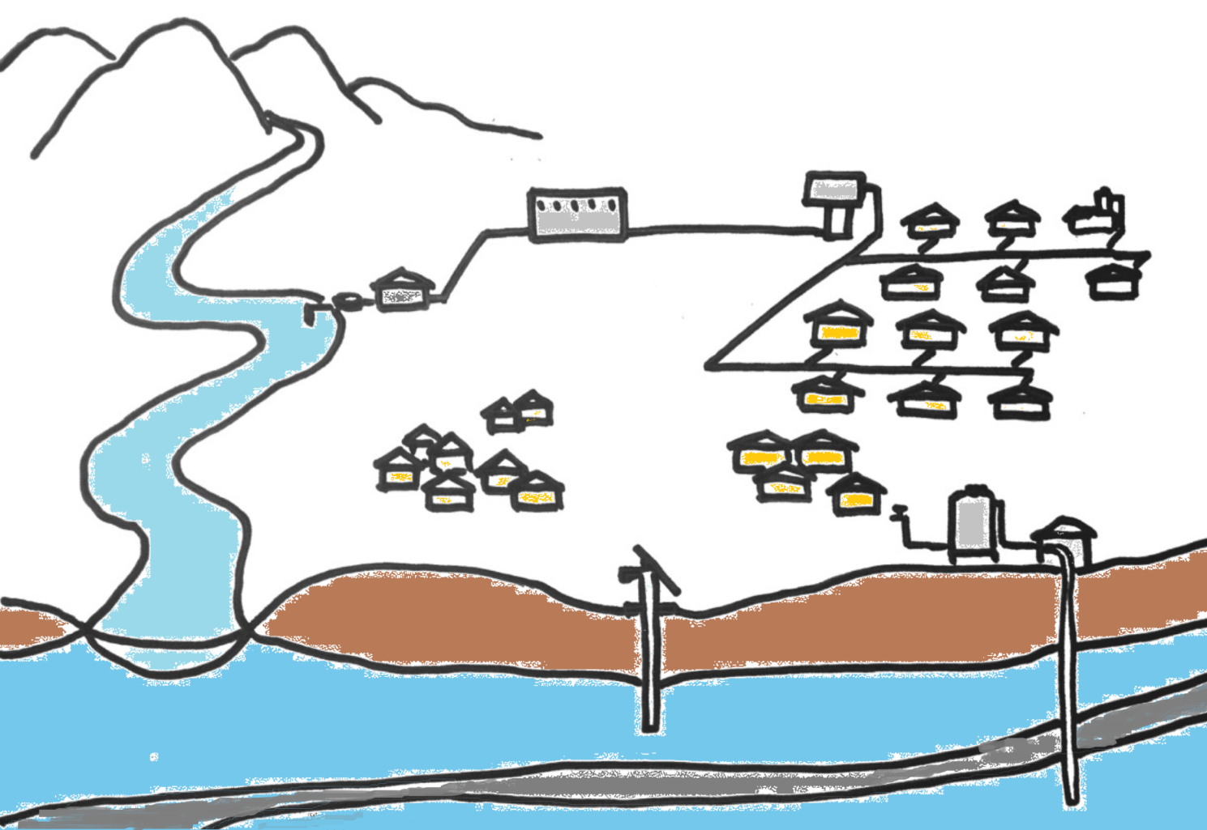

treatment
distribution
abstraction
intake
user safety
abstraction
transport
abstraction
source
intake
intake
Image: Maryna Peter
source
source
11

Slide 12
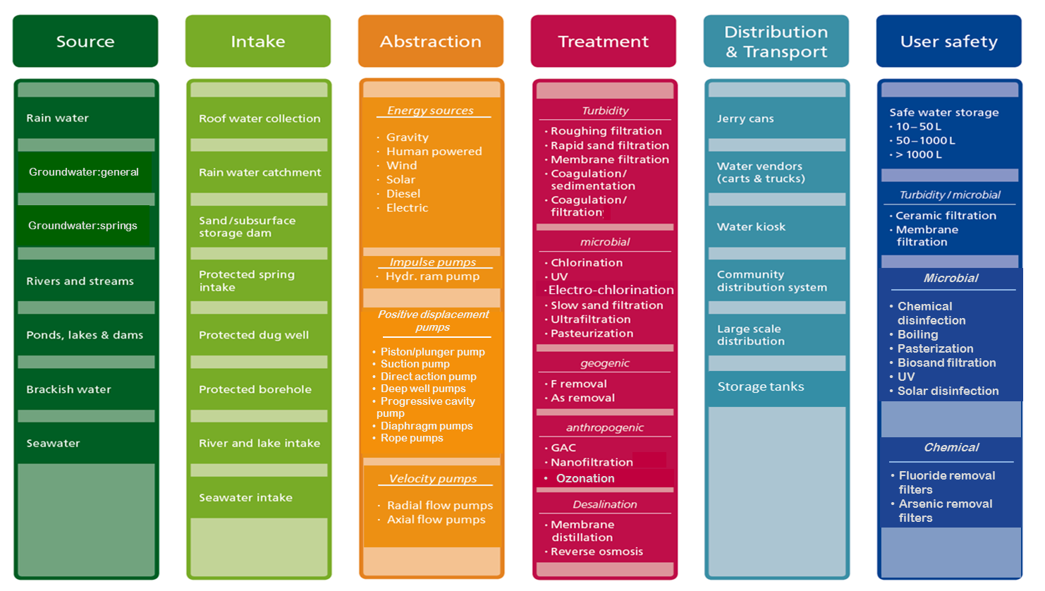
Functional groups:
Technological steps from source to consumer
Which technologies perform each role?
Technology information sheets
12

Slide 13
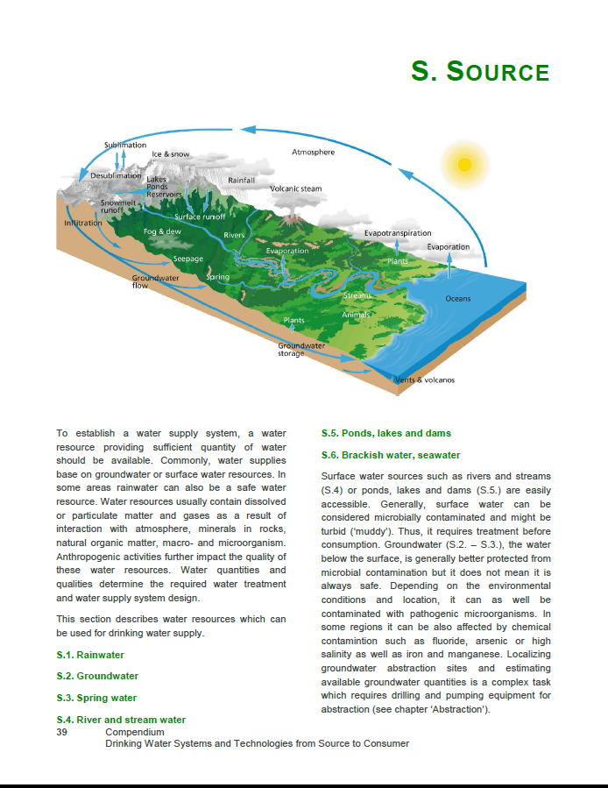
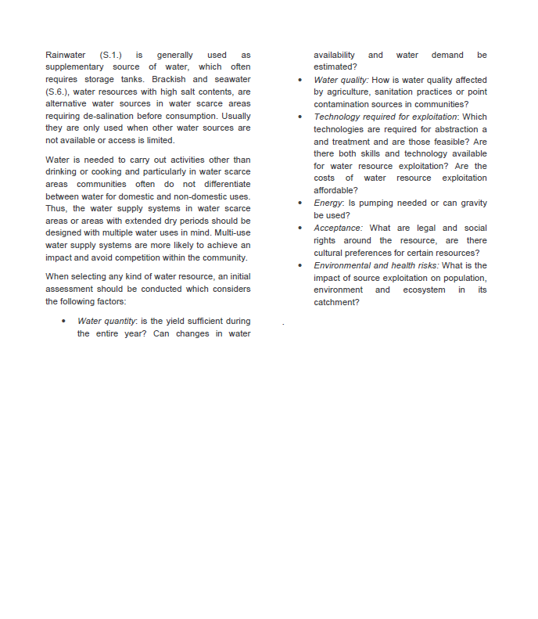
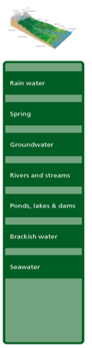
Technology information sheets
source
criteria for selection
background info
13

Slide 14
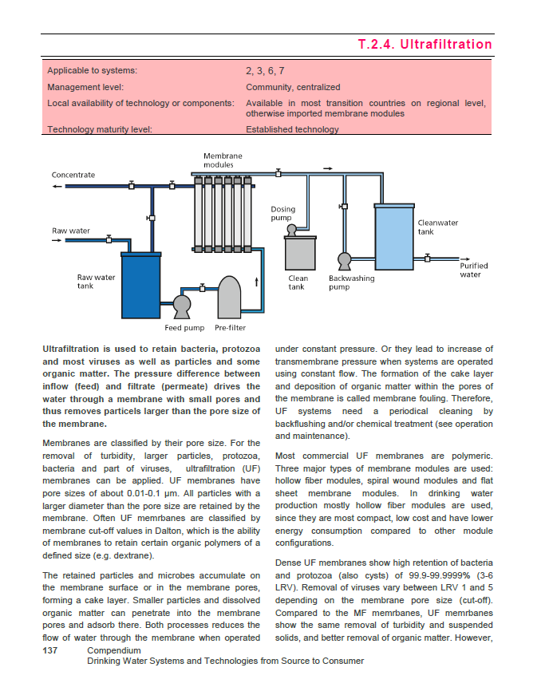
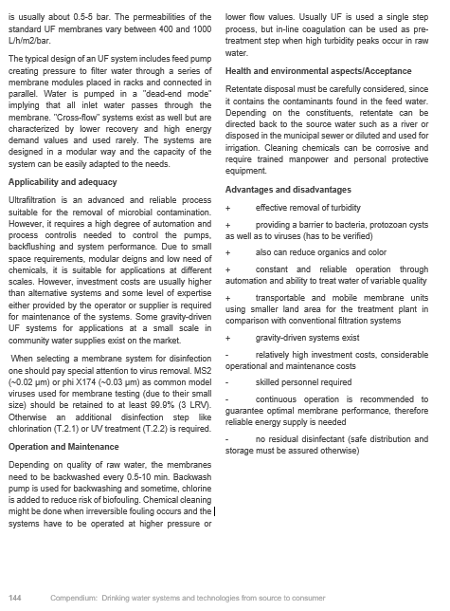
Technology information sheets
Applicable to systems:
Management level:
Local availability of technology or components:
Technology maturity level:
2,3,7,8
Community, centralized
Available in most middle income countries, otherwise imported membrane modules
Established technology
health & environmental aspects/ Acceptance
schematic presentation/drawing
applicability & adequacy
advantages & disadvantages
operational issues & functionality
operation & maintenance
14

Slide 15
Functional groups:
Technological steps from source to consumer
How to combine/link technologies?
System templates
15

Slide 16
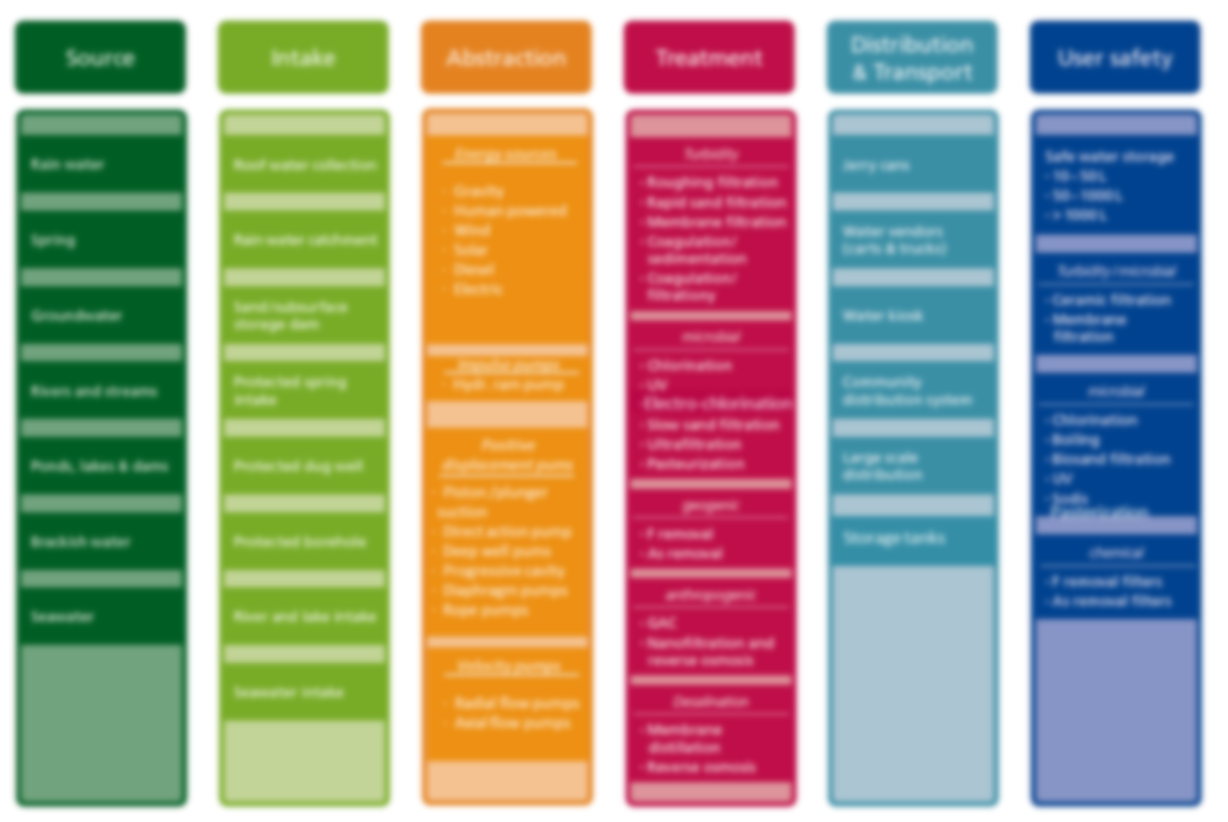
System templates
Turbidity
Roughing filtration
Rapid sand filtration
Membrane filtration
Coagulation/ sedimentation
Coagulation/ filtration
Safe water storage
10-50 L
50-1000 L
> 1000 L
Gravity
Electric
Microbial
Chlorination
UV
Electrochlorination
Slow sand filtration
Ultrafiltration
Pasteurization
Rivers & streams
Ponds, lakes & dams
Large scale distribution
River & lake intake
Velocity pumps
Radial flow pumps
Axial flow pumps
16

Slide 17
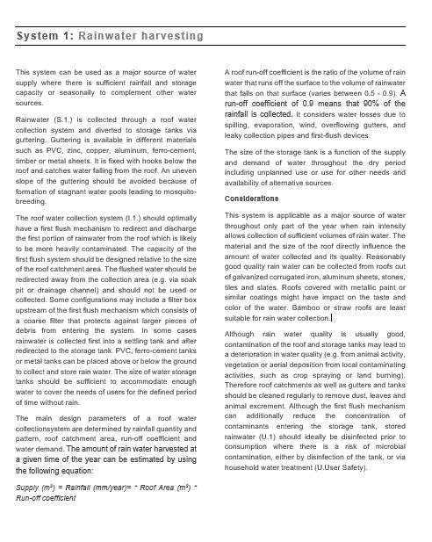
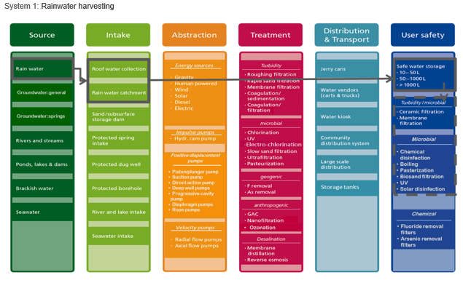
System templates
Design parameters
Source
Considerations regarding applicability
Intake system
Storage system
17

Slide 18
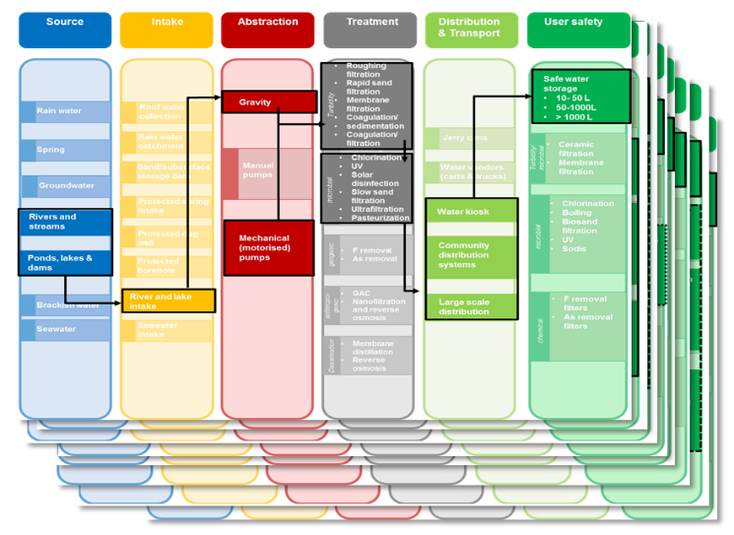
Structure of the Compendium
Part 1. System templates
System 1 | Rainwater harvesting
System 2 | Surface water treatment centralized
System 3 | Surface water treatment decentralized
System 4 | All fresh water sources: manual transport with household water treatment
System 5 | Gravity flow supplies
System 6 | High quality groundwater
System 7 | Decentralized groundwater treatment with geogenic contamination
System 8 | All fresh water sources with anthropogenic contamination
System 9 | Desalination of brackish and salt water
Part 2. Technology information sheets
Part 3. Cross-cutting issues
18

Slide 19
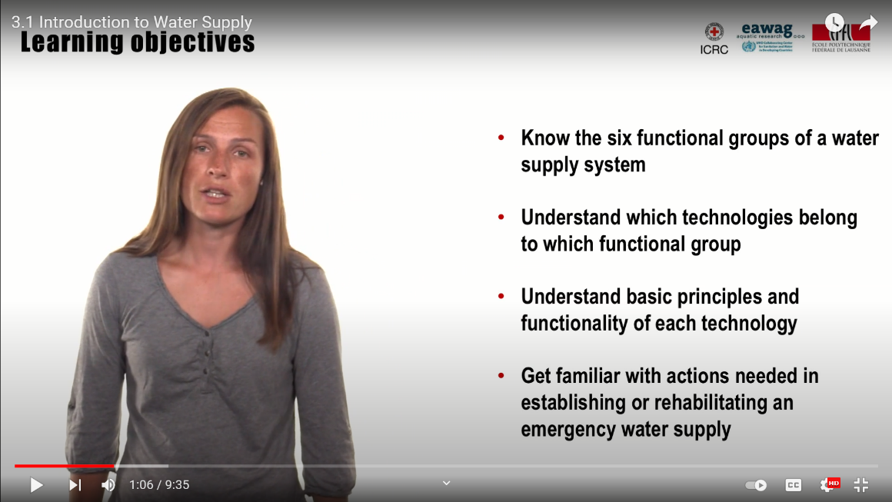
Water supplies (10’) https://youtu.be/NDYFVgH4O3A
Optional viewing
Maryna Peter introduces the 6 functional groups of a water supply system (source, intake, abstraction, treatment, distribution & transport and user safety), a combination of which can be applied to any water supply. However, all solutions have to be adapted to the local context.
19

Slide 20
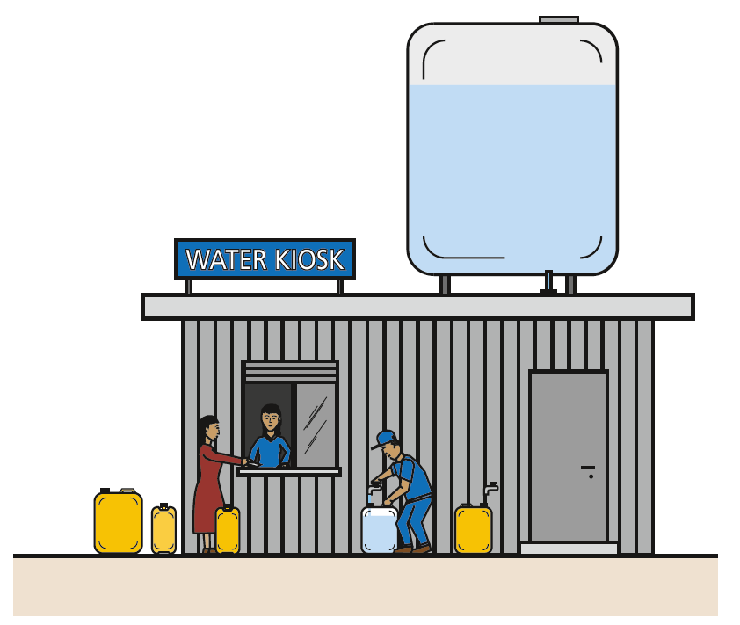
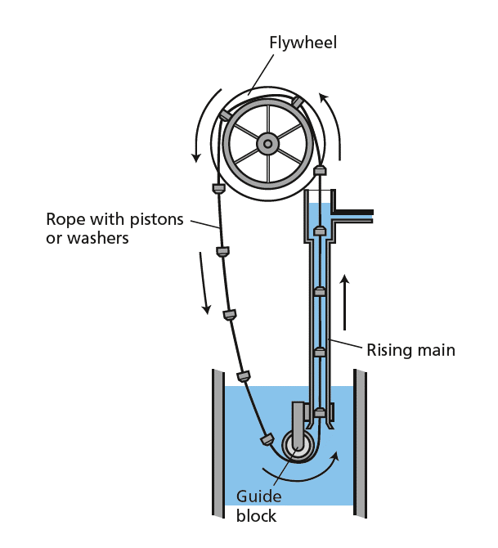
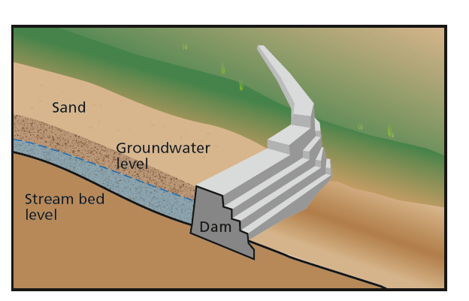
Learning objective 3:
Describe the advantages and drawbacks of (a selection) of water supply technologies
20

Slide 21
SOURCES
S.1 Rainwater
S.2 Groundwater
S.3 Spring water
S.4 River and stream water
S.5 Ponds, lakes, and dams
S.6 Brackish water, seawater
21

Slide 22
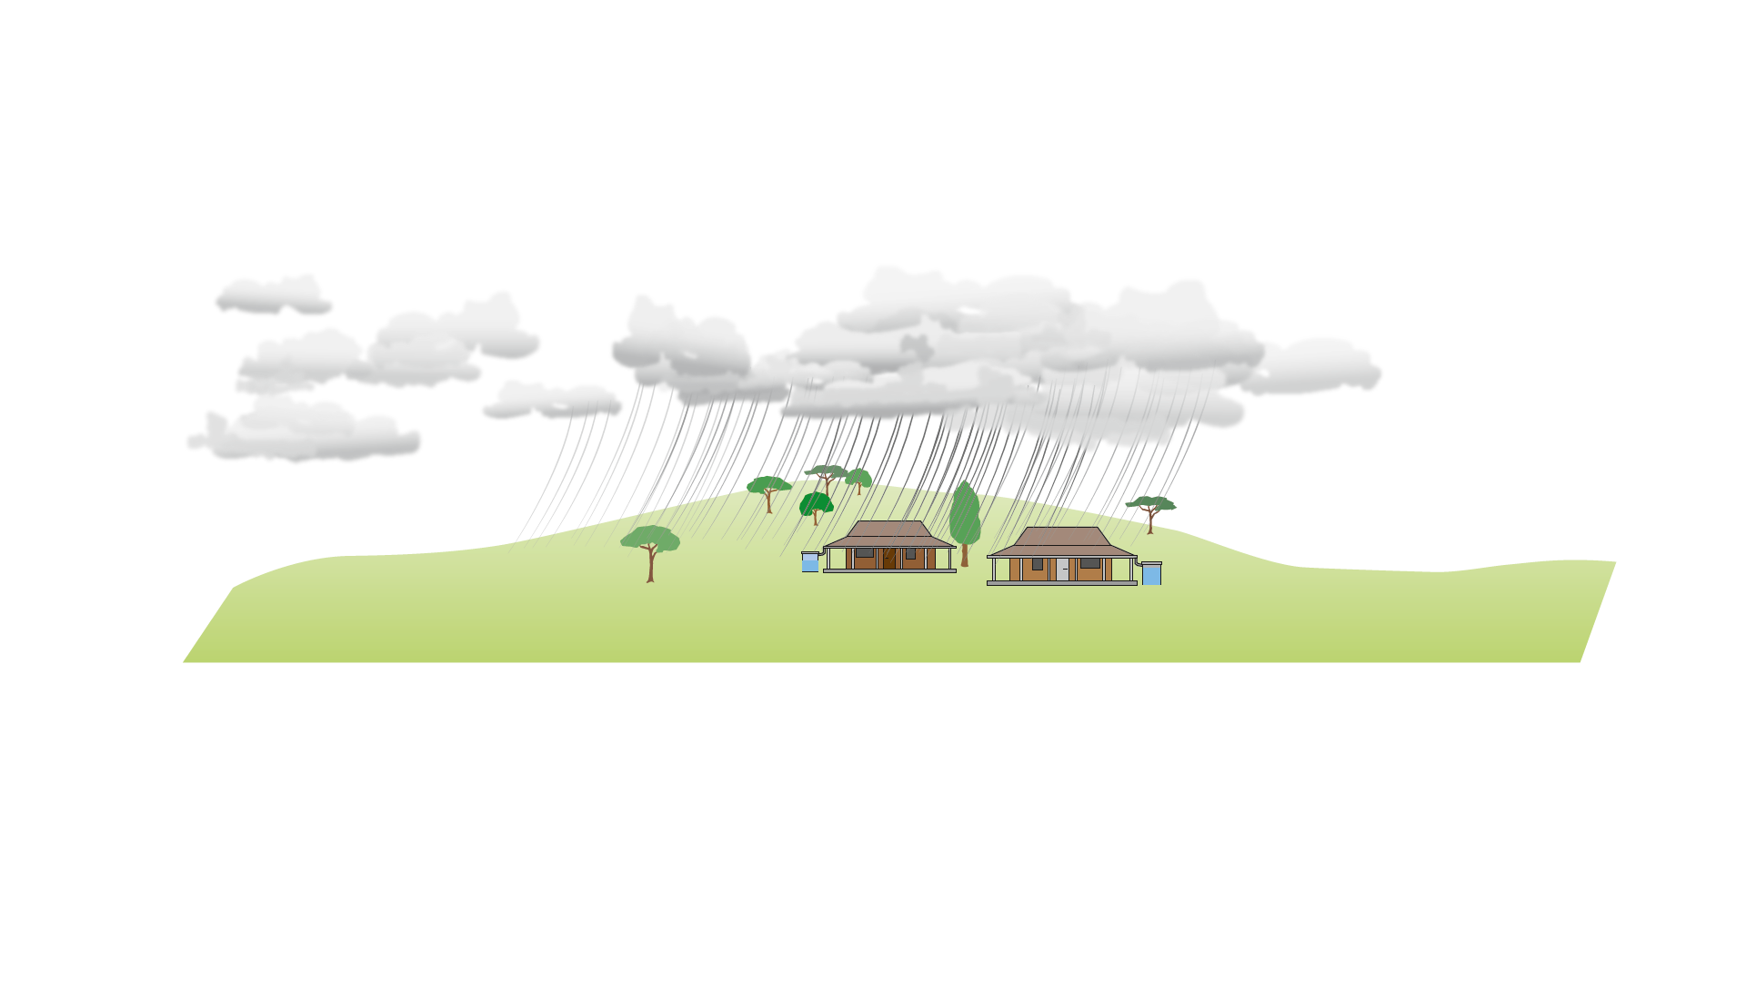

S.1 Rainwater
Applicability: Health/environmental aspects: Advantages/disadvantages:
22

Slide 23
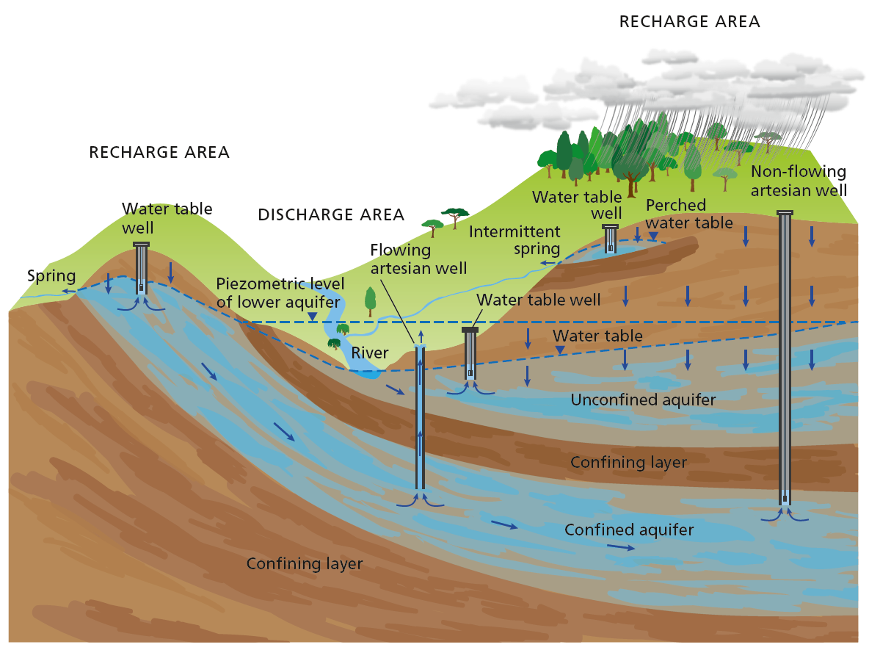
S.2 Groundwater
Applicability:
Health/environmental aspects:
Advantages/disadvantages:
23

Slide 24
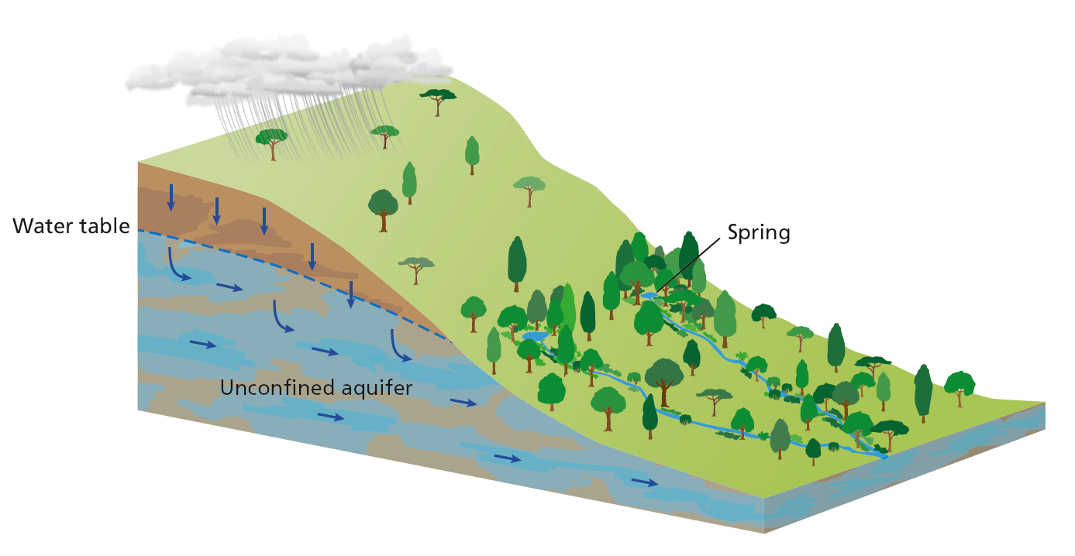
S.3 Spring water
Applicability:
Health/environmental aspects:
Advantages/disadvantages:
24

Slide 25
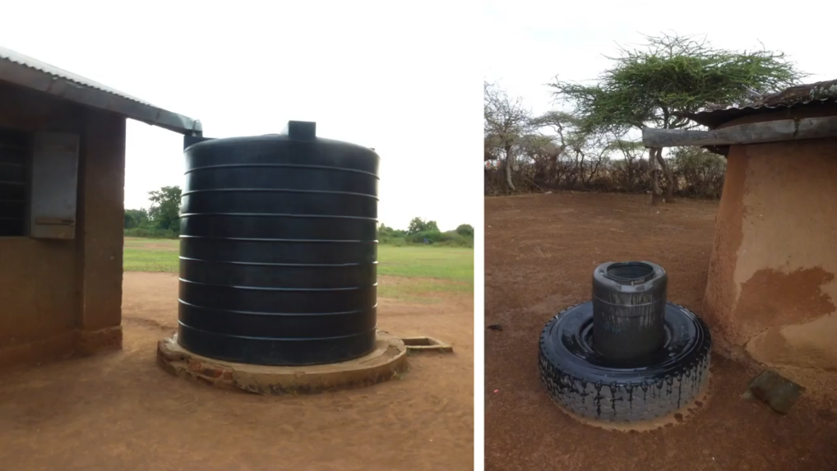
Source selection (10’) https://youtu.be/FvXi6srkeLk
Optional viewing
A description of the criteria to select a water source, with the advantages and disadvantages of the main types of water source:
Surface water (Rivers, lakes and reservoirs)
Groundwater (springs, wells)
Rainwater
Brackish and sea water
25

Slide 26
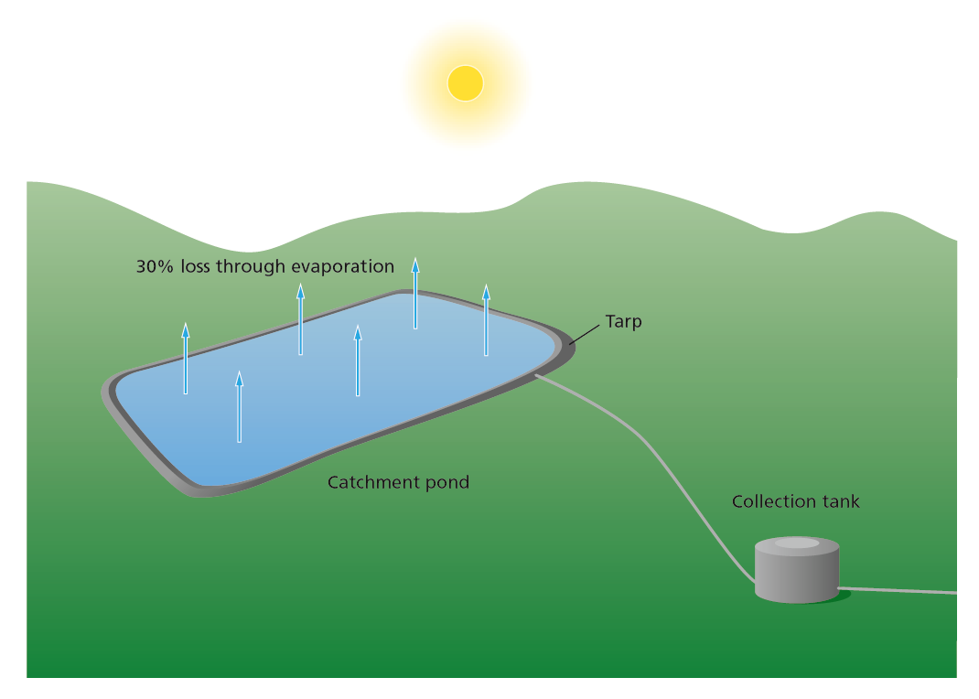
INTAKE
I.1 Roof water collection
I.2 Rainwater catchment dam
I.3 Sand/ subsurface dam
I.4 Protected spring intake
I.5 Protected dug wells
I.6 Protected boreholes
I.7 River and lake water intake
I.8 Riverbank filtration
I.9 Seawater intake
26

Slide 27
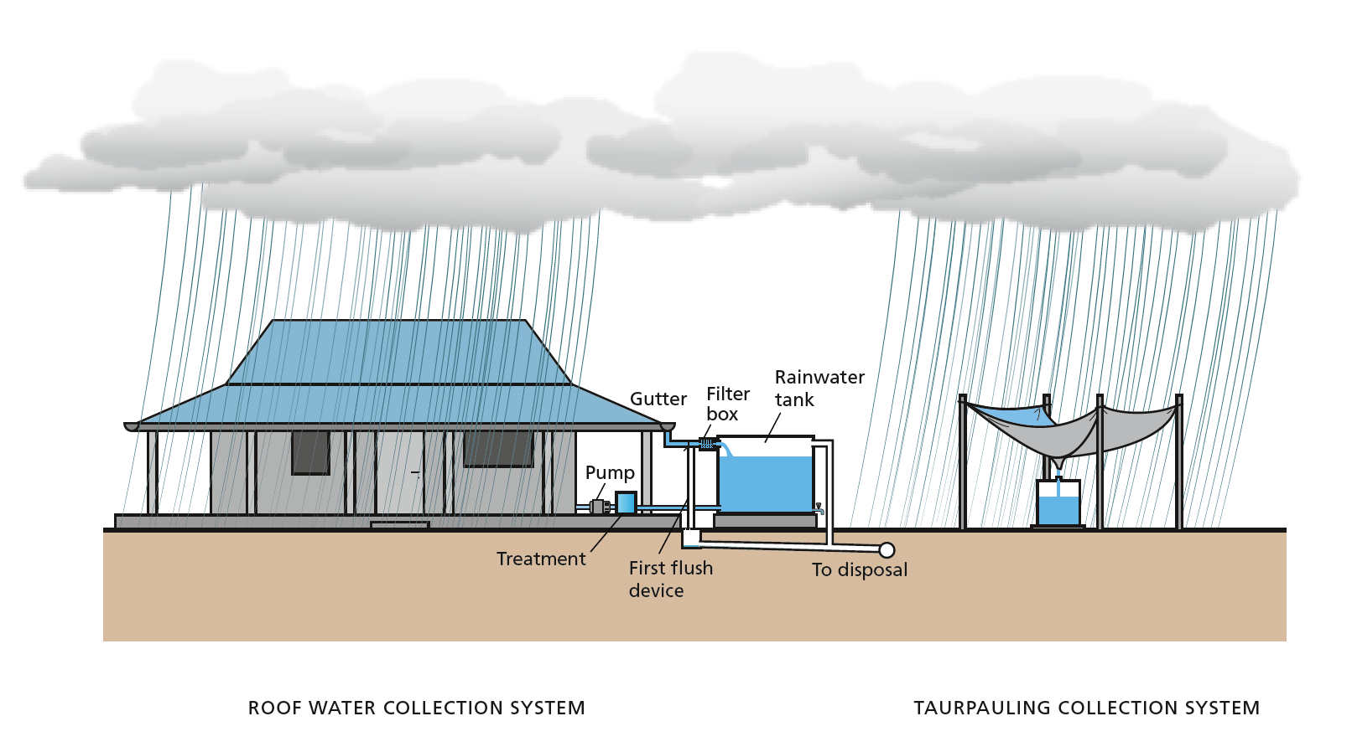
I.1 Roof water collection system
Applicability:
Health/environmental aspects:
Advantages/disadvantages:
27

Slide 28
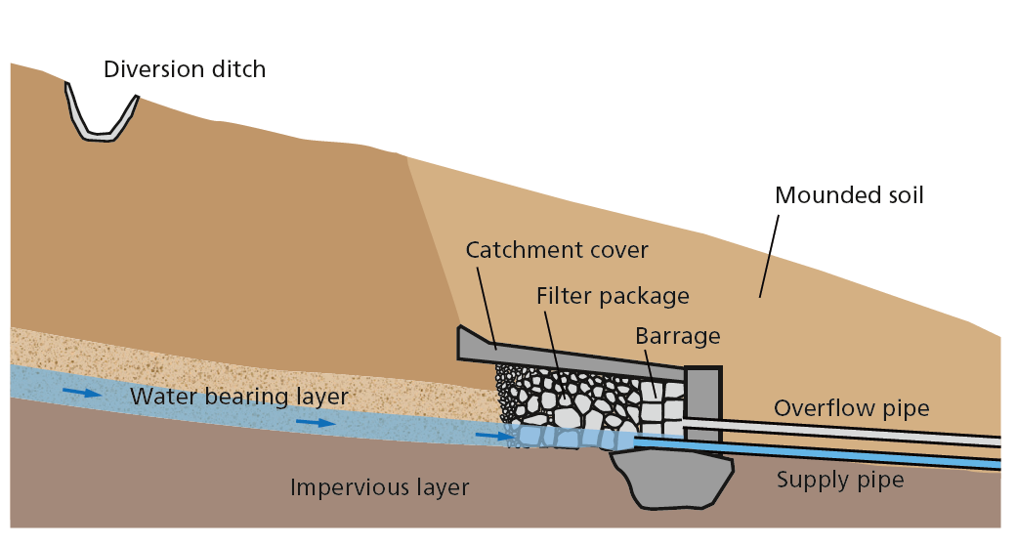
I.4 Protected spring intake
Applicability:
Health/environmental aspects:
Advantages/disadvantages:
28

Slide 29
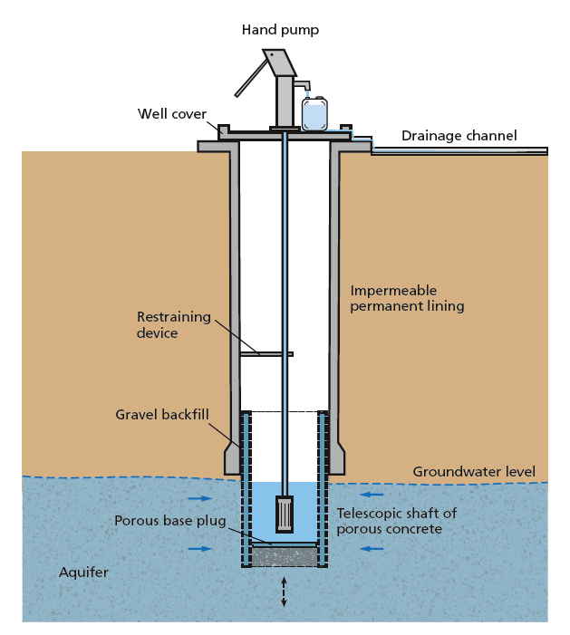
I.5 Protected dug wells
Applicability:
Health/environmental aspects:
Advantages/disadvantages:
29

Slide 30
ABSTRACTION
A.1 Hydraulic ram pump
A.2 Piston/ plunger suction pumps
A.3 Direct action pump
A.4 Piston pump/ deep well pump
A.5 Progressive cavity pump
A.6 Diaphragm pump
A.7 Rope and washer pump
A.8 Radial flow pumps
A.9 Axial flow pumps
A.10 Gravity
A.11 Human powered
A.12 Wind
A.13 Solar
A.14 Electric
A.15 Internal combustion engine
30

Slide 31
A.4 Piston pump/ deep well pump (positive displacement)
Applicability:
Health/environmental aspects:
Advantages/disadvantages:
31

Slide 32
A.7 Rope pump (positive displacement)
Applicability:
Health/environmental aspects:
Advantages/disadvantages:
32

Slide 33
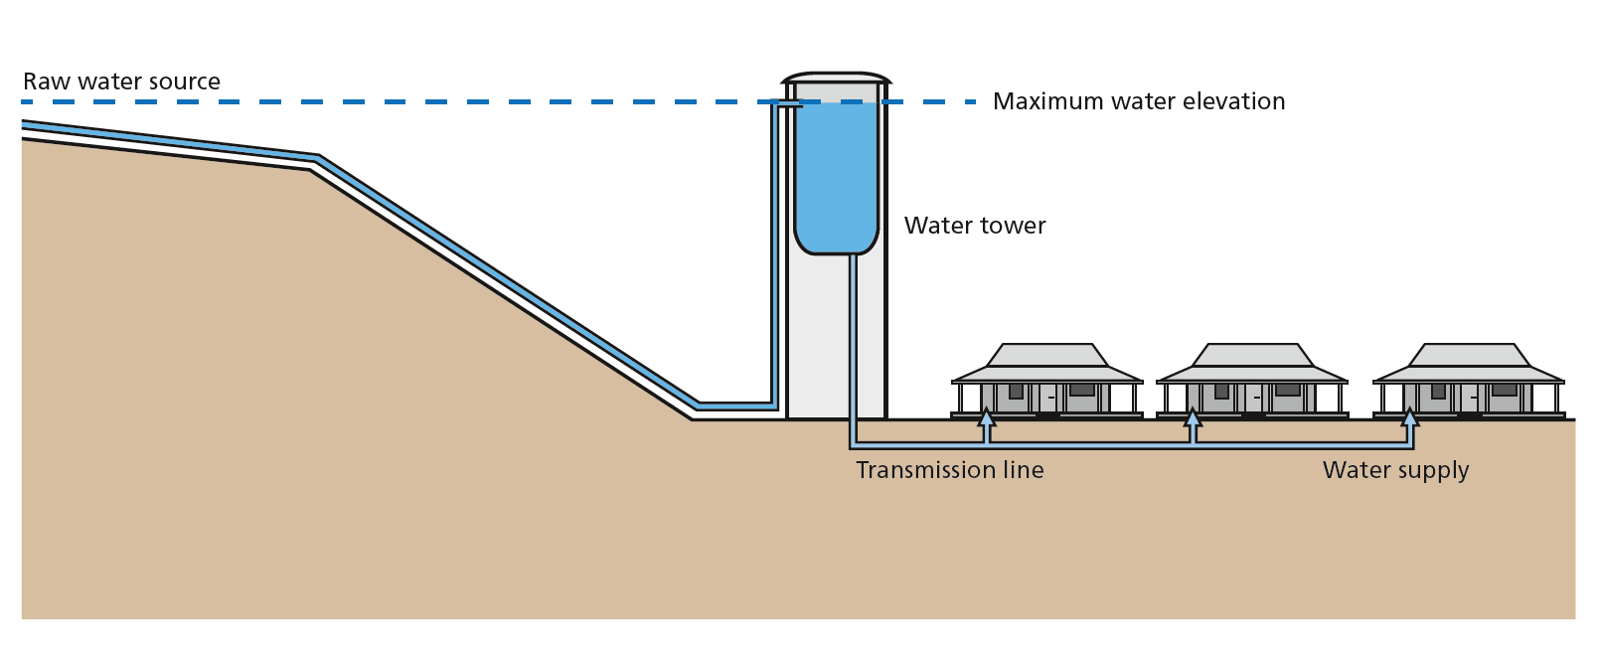
A.10 Gravity (energy source)
Applicability: Health/environmental aspects: Advantages/disadvantages:
33

Slide 34
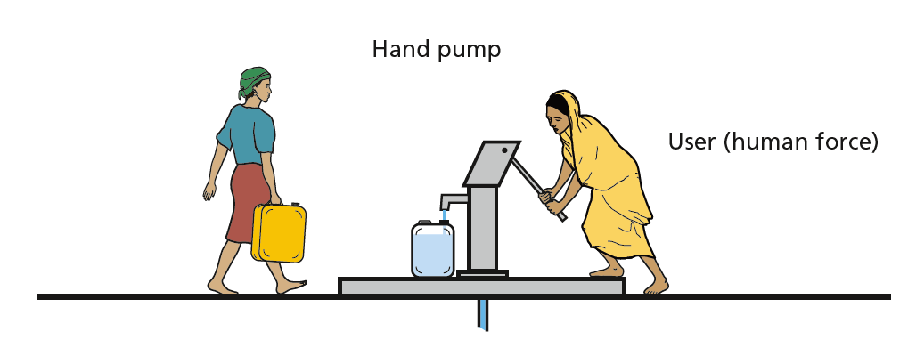
A.11 Human powered (energy source)
Applicability: Health/environmental aspects: Advantages/disadvantages:
34

Slide 35
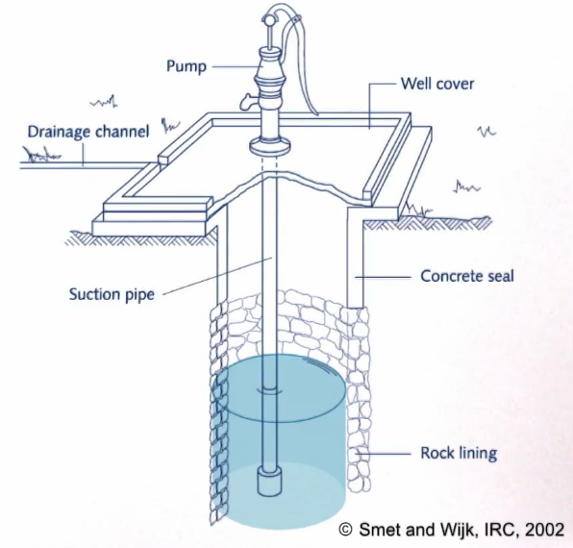
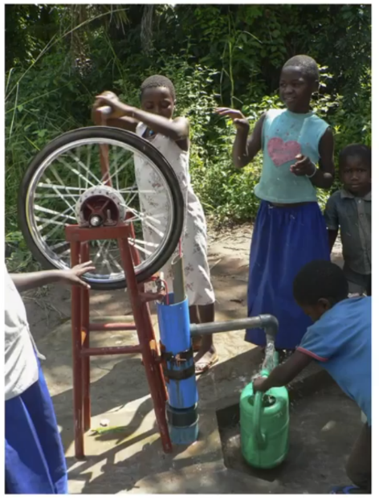
Intake (8’) https://youtu.be/QaYMbub4ljw
Abstraction (12’) https://youtu.be/bVsMCIy11_4
Optional viewing
An overview of the water intake options, their applicability and limitations.
A detailed overview of water abstraction options, to collect water at the source intake system and transport it (to the treatment plant, or storage tank, or distribution network, or consumer).
35

Slide 36
TREATMENT
T.1 Clarification methods
T.1.1 Roughing filtration
T.1.2 Rapid sand filtration
T.1.3 Microfiltration
T.1.4 Coagulation/ flocculation/ sedimentation
T.1.5 Coagulation/ flocculation/ filtration
T.2 Removal/ inactivation of microorganisms
T.2.1 Chlorination
T.2.2 On-site electrochlorination
T.2.3 UV disinfection
T.2.4 Slow sand filtration
T.2.4 Ultrafiltration
T.2.5 Pasteurization
T.3 Treatments for geogenic contaminants
T.3.1 Fluoride removal methods
T.3.2 Arsenic removal methods
T.4 Treatments for organic and inorganic contaminants
T.4.1 Activated carbon
T.4.2 Ozonation
T.4.3 Nanofiltration
T.5 Desalination (salt removal)
T.5.1 Membrane distillation
T.5.2 Reverse osmosis
36

Slide 37
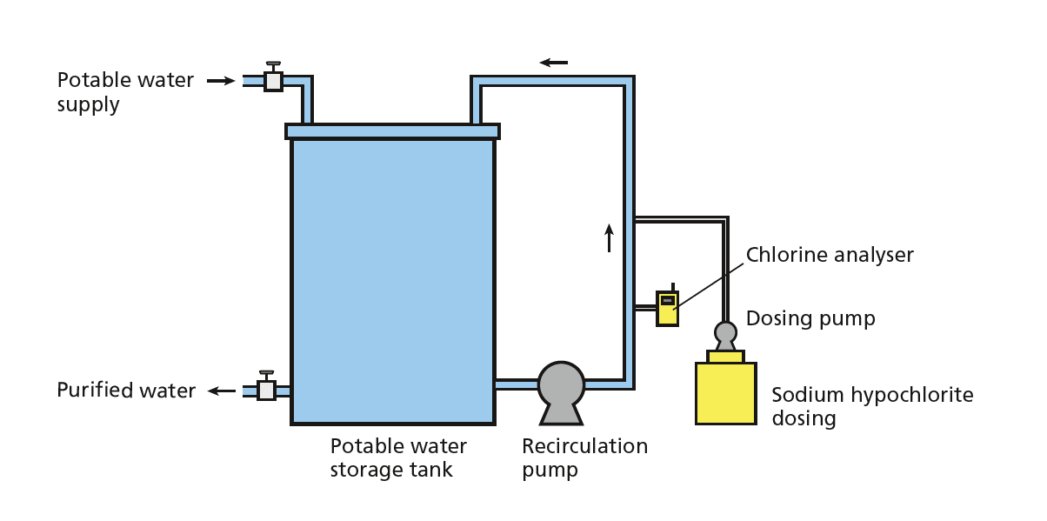
T.2.1 Chlorination
Applicability:
Health/environmental aspects:
Advantages/disadvantages:
37

Slide 38
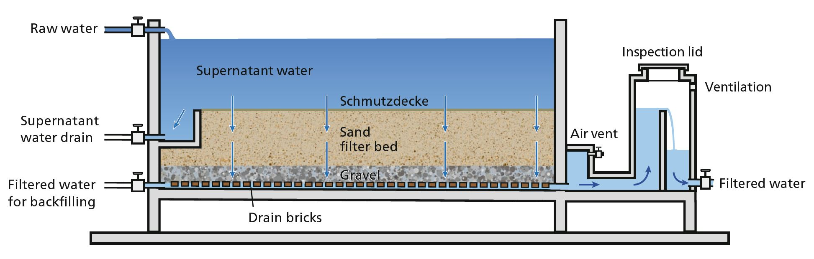
T.2.4 Slow sand filtration
Applicability: Health/environmental aspects: Advantages/disadvantages:
38

Slide 39
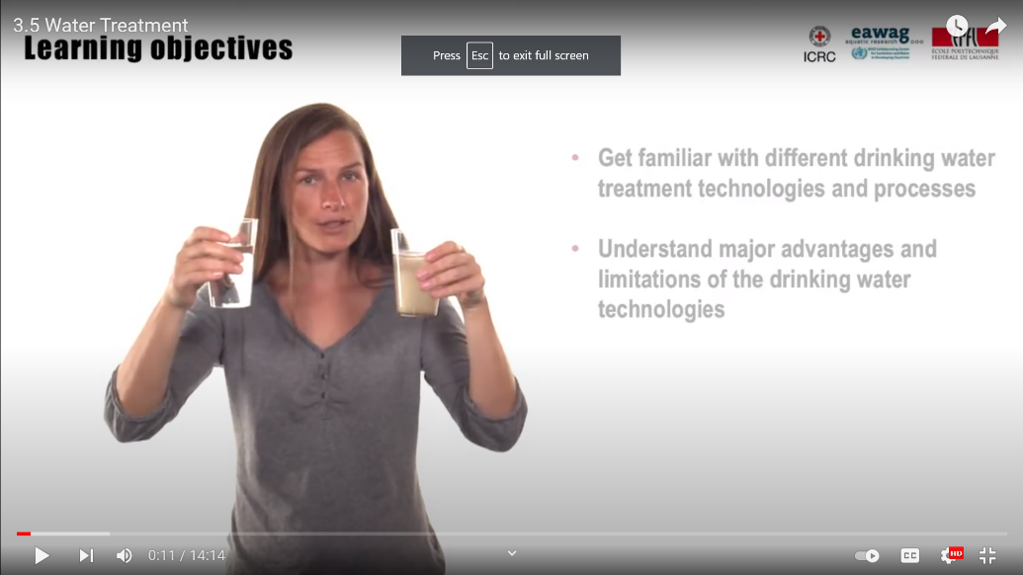
Water Treatment (14’) https://youtu.be/lAE7YKK0TkA
Optional viewing
A description of the criteria for selecting water treatment technologies, with the advantages and disadvantages of the main categories of treatment:
Clarification methods
Removal of microorganisms
Treatments of geogenic contaminants
Treatments of organic and inorganic contaminants
Desalination

Slide 40
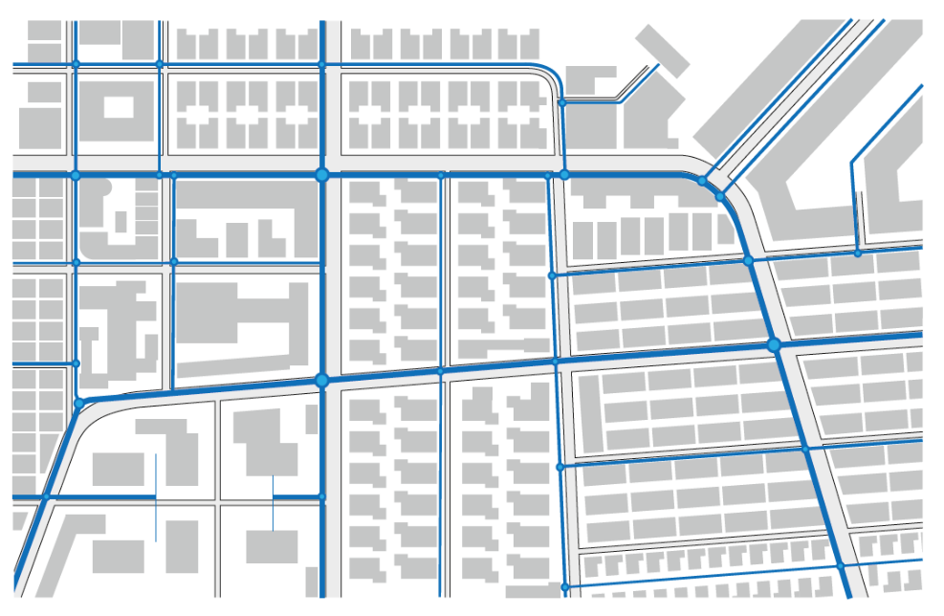
DISTRIBUTION AND TRANSPORT
D.1 Jerry cans
D.2 Water vendors (carts and trucks)
D.3 Water kiosks
D.4 Small public and community distribution systems
D.5 Centralized distribution systems
D.6 Storage tanks and reservoirs
40

Slide 41
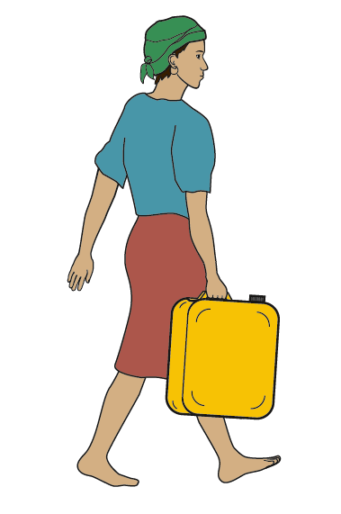
D.1 Jerry cans
Applicability:
Health/environmental aspects:
Advantages/disadvantages:
41

Slide 42
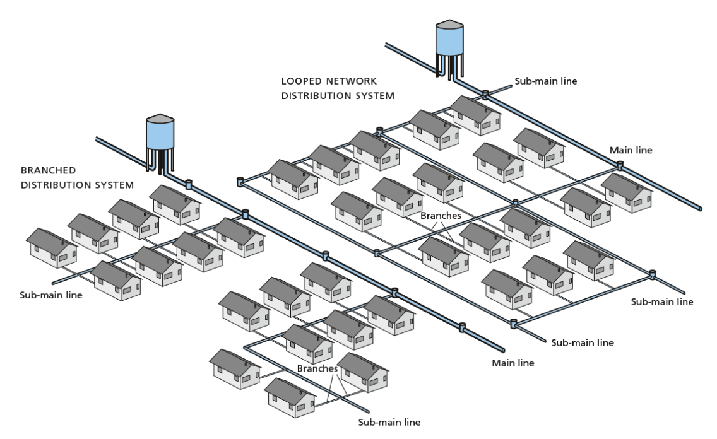
D.4 Small public and community distribution systems
Applicability:
Health/environmental aspects:
Advantages/disadvantages:
42

Slide 43
USER SAFETY
U.1 Safe water storage
U.2 Ceramic filtration
U.3 Ultrafiltration
U.4 Chemical disinfection
U.5 Boiling
U.6 Pasteurization
U.7 Biosand filtration
U.8 UV light disinfection
U.9 Solar water disinfection
U.10 Fluoride removal filters
U.11 Arsenic removal filters
43

Slide 44
U.1 Safe water storage
Applicability:
Health/environmental aspects:
Advantages/disadvantages:
44

Slide 45
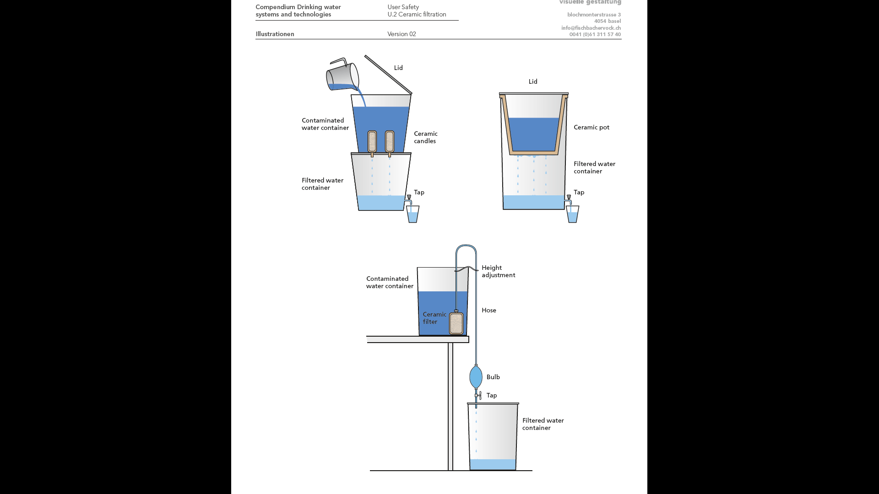

U.2 Ceramic filtration
Applicability:
Health/environmental aspects:
Advantages/disadvantages:
45

Slide 46

Distribution, transport and user safety (10’) https://youtu.be/qnoF7QLIPYQ
Optional viewing
An overview of the distribution options for water (in terms of possibility, costs, safety, convenience, complexity,…), and user safety.
46

Slide 47
Water System Design
Turbidity
Roughing filtration
Rapid sand filtration
Membrane filtration
Coagulation/ sedimentation
Coagulation/ filtration
Safe water storage
10-50 L
50-1000 L
> 1000 L
Gravity
Electric
Microbial
Chlorination
UV
Electrochlorination
Slow sand filtration
Ultrafiltration
Pasteurization
Rivers & streams
Ponds, lakes & dams
Large scale distribution
Learning objective 4:
Illustrate a system template for a ‘real world’ scenario
River & lake intake
Velocity pumps
Radial flow pumps
Axial flow pumps
47

Slide 48

Design consideration: Source suitability
Rainwater microbiological quality good
contains few minerals
utilisation easy
storage necessary
Ground water microbiological quality good
risk of geogenic contamination
contamination possible
for (2) & (3)
usually no treatment necessary
utilisation easy (3) => difficult (1)
Surface water great risk for microbiological contamination
high content of solids and algii
treatment necessary
48

Slide 49
Criteria for selecting a source
1. Quantity of water the source can provide
  Immediate capacity & Reliability over time (dry season)
2. Quality of water
  Present quality & Risk of pollution
3. Technology required for exploitation:
  Type of technology required (cost and technical requirements for installation & maintenance)
  Social acceptance
4. Accessibility
  Geographical, Social, Financial, Security
49

Slide 50
Design consideration: Treatment needs
Avoid treatment (source!)
high investment and maintenance cost
availability of spare parts & chemical difficult
lack of trained personnel
Goal
utilisation of water with low health risk => ground water and spring water
protection of the water source
No treatment necessary is the best treatment
Treatment Parameters
Microbiological contamination
Turbidity (silt, clay, algii)
Geogenic contaminants:, Arsenic, Fluoride, Iron, Manganese
Antropogenic chemicals
50

Slide 51
Addressing different quality issues
Quality issue | Examples of suitable technologies
Turbidity
Surface Water | Flocculation, Sedimentation Roughing & Slow Sand Filtration
Desalination
Saline, backish groundwater, sea water | Reverse osmosis (RO), Distillation
Removing chemical contamination
Fluoride: Groundwater | Adsorption to activated alumina or bone char, RO
Arsenic: Groundwater | Oxidation, adsorption & ion exchange, RO, Distillation
Anthropogenic pollution: Surface water | Reverse Osmosis, Distillation
Removing microbiological contamination
Contaminated surface water, groundwater, rainwater | Slow sand filtration, chlorination, UV, ultrafiltration, pasteurization
51

Slide 52
Additional design considerations
No treatment is the best treatment – use the water source with highest quality
Water transport distance is the main usage criteria of a water source – new water points must thus be closer than existing ones, otherwise they will not be used.
Gravity systems are more appropriate than systems requiring electrical pumps.
Keep supply networks simple, guarantee frequent controls and maintenance to minimize water losses.
Public taps are the interface between water supply and user – keep them user-friendly and robust.
Household storage is needed if water is collected away from the home or if the piped supply is intermittent
52

Slide 53
Group exercise
A small town in western Uganda has about 25’000 people, receives rain for three months out of the year and has easily accessible groundwater. The town has an urbanized core, while the surrounding outskirts are more rural in nature. In addition to households, there are two schools, a clinic and several small businesses.
Propose a possible water supply delivery configuration in the figure to the right.
Explain why this is the best configuration for the setting.
53

Slide 54


Group exercise
A small town in western Uganda has about 25’000 people, receives rain for three months out of the year and has easily accessible groundwater. The town has an urbanized core, while the surrounding outskirts are more rural in nature. In addition to households, there are two schools, a clinic and several small businesses.
Propose a possible water supply delivery configuration in the figure to the right.
Explain why this is the best configuration for the setting.
54

Slide 55
55

Slide 57




Internships and MSc projects at Sandec
Email Caterina.DallaTorre@eawag.ch
57

